Slide 1
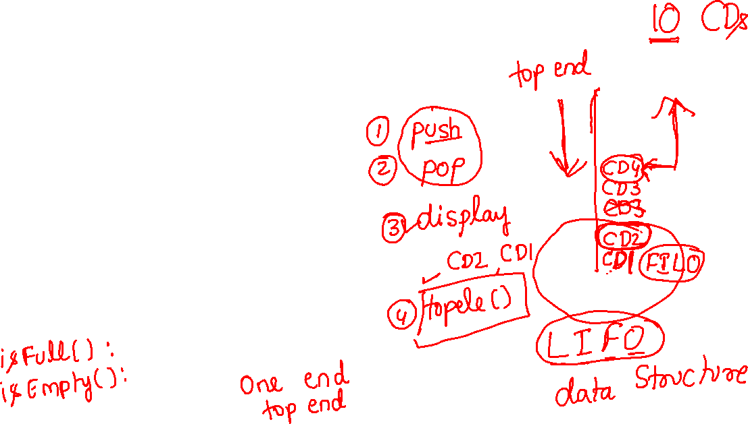

Stack
13-OCT-2021
Concept
Program
Reversing a string
Checking palindrome/not using stack
Base conversion using stack
Balanced Parenthesis check using stack

Slide 2
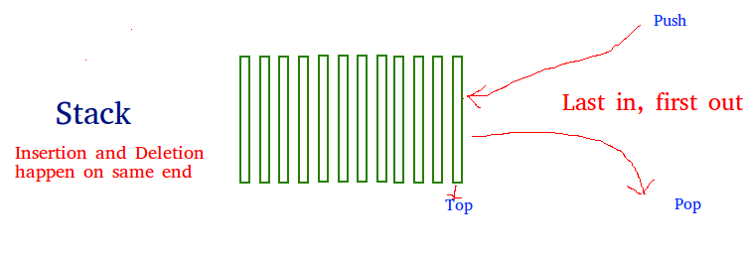
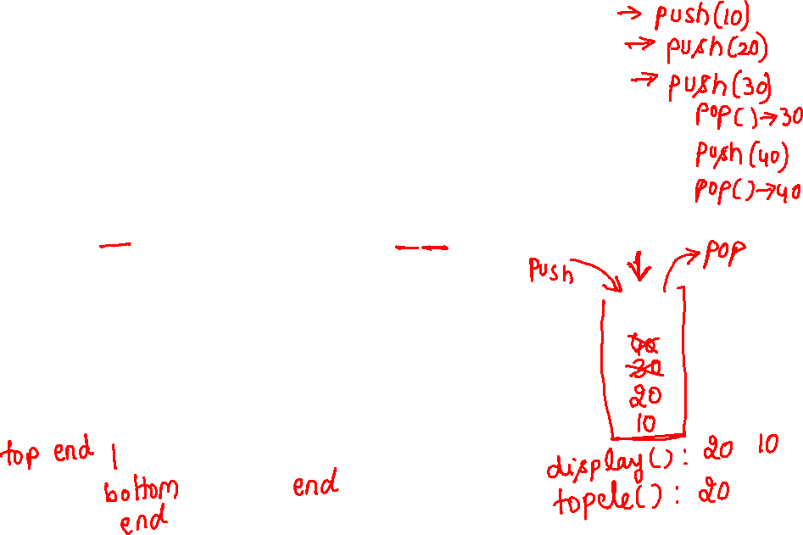
STACK
Stack is a linear data structure which follows a particular order in which the operations are performed.
The order may be LIFO(Last In First Out) or FILO(First In Last Out).

Slide 3
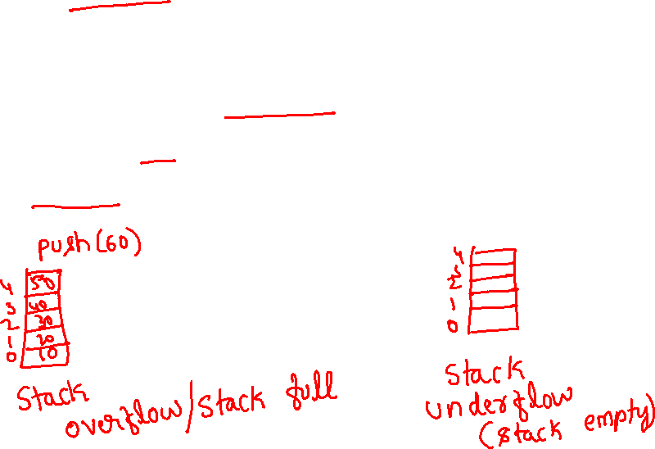
Push: Adds an item in the stack. If the stack is full, then it is said to be an Overflow condition.
Pop: Removes an item from the stack. The items are popped in the reversed order in which they are pushed. If the stack is empty, then it is said to be an Underflow condition.
Peek or Top: Returns top element of stack.
isEmpty: Returns true if stack is empty, else false.

Slide 4
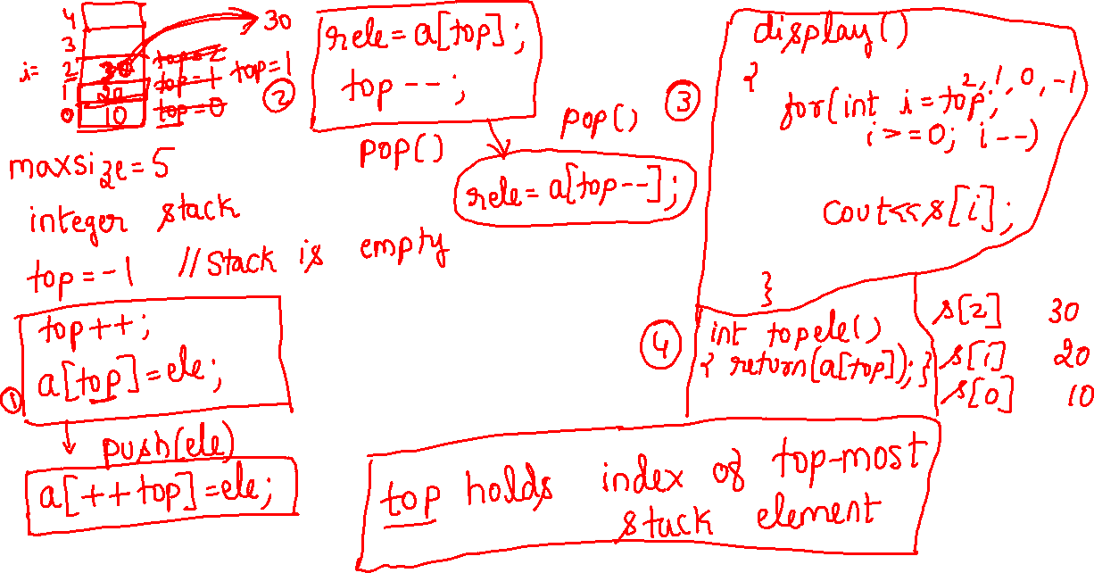

Slide 5
#include <iostream>
using namespace std;
#define MAX 1000
class Stack {
int top;
public:int a[MAX]; // Maximum size of Stack
Stack() { top = -1; }
void push(int);
int pop();
int peek();
void display();
int isEmpty();
};

Slide 6
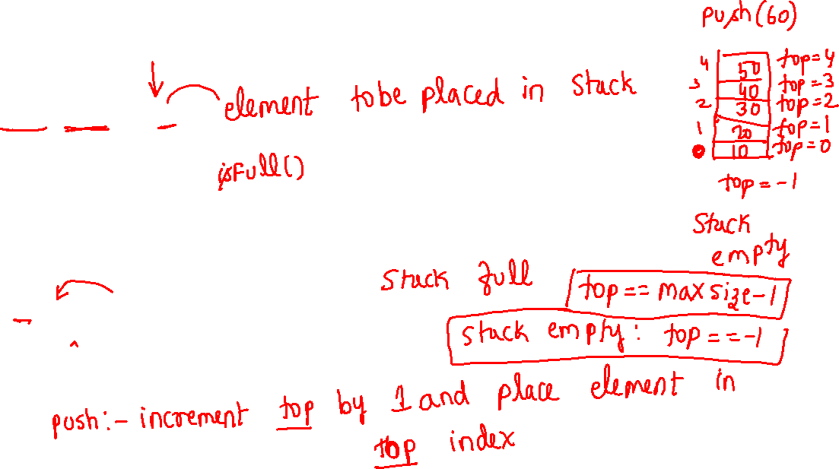
void Stack::push(int x)
{
if (top >= (MAX - 1)) {
cout << "Stack Overflow";
}
else {
a[++top] = x;
cout << x << " pushed into stack\n";
}
}

Slide 7
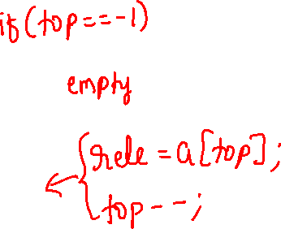
int Stack::pop()
{
if (top < 0) {
cout << "Stack Underflow";
return 0;
}
else {
int x = a[top--];
return x;
}
}

Slide 8
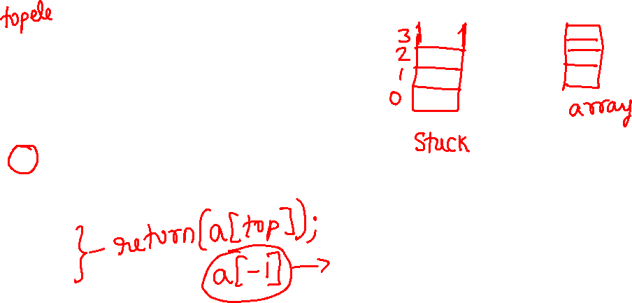
int Stack::peek()
{
if (top < 0) {
cout << "Stack is Empty";
return 0;
}
else {
int x = a[top];
return x;
}
}

Slide 9
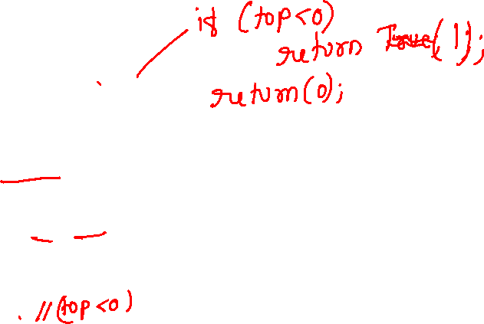
int Stack::isEmpty()
{
return (top < 0);
}
void Stack::display() {
if(top>=0) {
cout<<"Stack elements are:";
for(int i=top; i>=0; i--)
cout<<a[i]<<" ";
cout<<endl;
} else
cout<<"Stack is empty";}

Slide 10
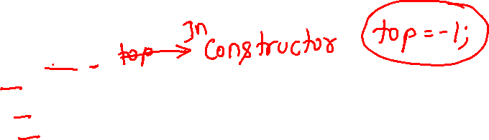
int main()
{
Stack s;
s.push(10);
s.push(20);
s.push(30);
cout << s.pop() << " Popped from stack\n";
s.display();
cout<<"The element at the top of stack is"<<s.peek();
return 0;
}

Slide 11
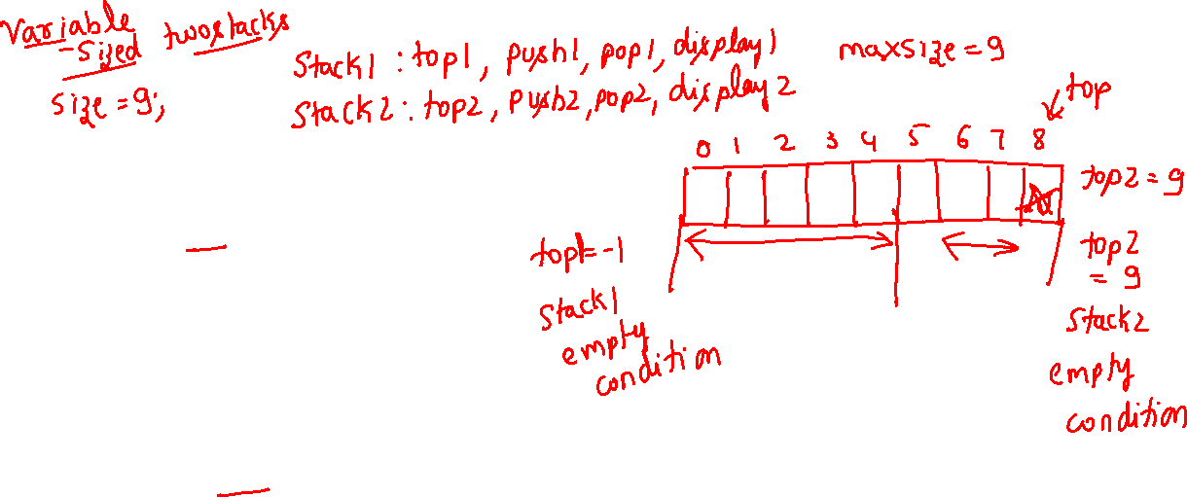
class twoStacks
{
int arr[size];
int top1, top2;
public:
twoStacks() // constructor
{
top1 = -1;
top2 = size;
}

Slide 12
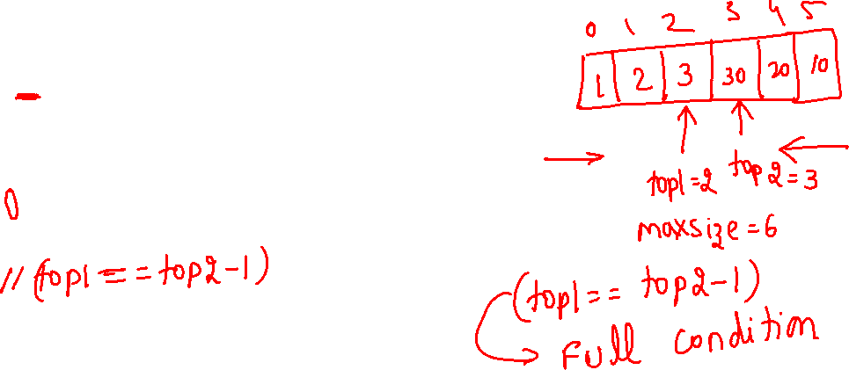
// Method to push an element x to stack1
void push1(int x)
{
// There is at least one empty space for new element
if (top1 < top2 - 1)
{
top1++;
arr[top1] = x;
}
else
{
cout << "Stack Overflow";
}
}

Slide 13
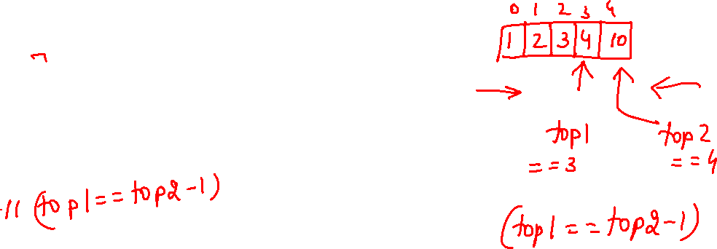
// Method to push an element x to stack2
void push2(int x)
{
// There is at least one empty space for new element
if (top1 < top2 - 1)
{
top2--;
arr[top2] = x;
}
else
{
cout << "Stack Overflow";
}
}

Slide 14
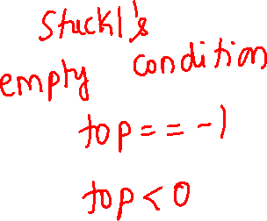
// Method to pop an element from first stack
void pop1()
{
if (top1 >= 0 )
{
int x = arr[top1];
top1--;
cout<<“popped element is”<<x;
}
else
{
cout << "Stack UnderFlow";
}
}

Slide 15
// Method to pop an element from second stack
void pop2()
{
if (top2 < size)
{
int x = arr[top2];
top2++;
cout<<“popped element is”<<x;
}
else
{
cout << "Stack UnderFlow";
}
}
};

Slide 16
int main()
{
twoStacks ts;
ts.push1(5);
ts.push2(10);
ts.push2(15);
ts.push1(11);
ts.push2(7);
cout << "Popped element from stack1 is " << ts.pop1();
ts.push2(40);
cout << "\nPopped element from stack2 is " << ts.pop2();
return 0;

Slide 17
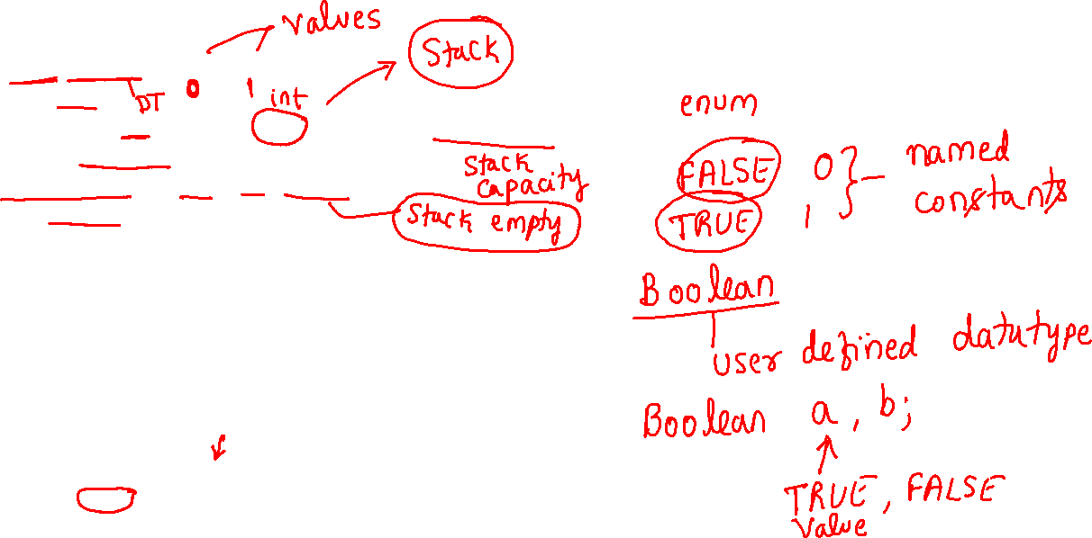
#include<iostream>
#include<string.h>
using namespace std;
enum Boolean{FALSE,TRUE};
class stack
{ int top; char a[20]; int maxsize;
public: stack( ){}
stack(int size){maxsize=size;top=-1;}
Boolean Isfull()
{
if(top==maxsize-1) return TRUE;
return FALSE;
}
Boolean Isempty()
{ if(top==-1) return TRUE;
return FALSE;
}
void push(char x);
char pop();
void display();
};
Character Stack

Slide 18

void stack::push(char x)
{ if(Isfull())
cout<<"Stack is full \n";
else
a[++top]=x;
}
char stack::pop()
{
if(Isempty())
{
cout<<"stack is empty\n";
return(-1);
}
else return(a[top--]);
}

Slide 19
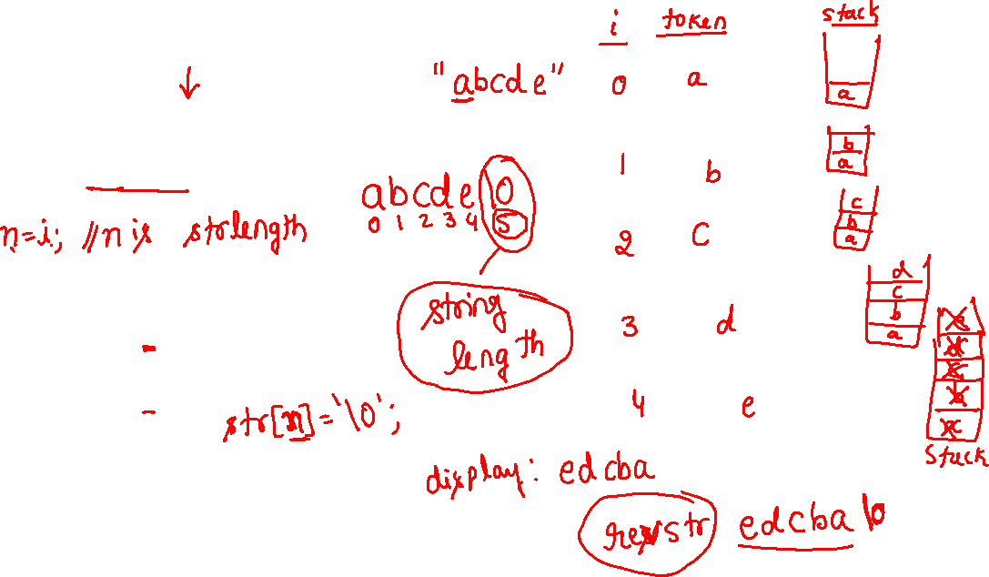
void reverse(char str[]){
int i=0,n;
while(str[i]!=‘\0’) i++;
n=i;
stack s(10);
for(i = 0; i < n; i++) s.push(str[i])
for(i = 0; i < n; i++)
str[i] = s.pop();
cout<<‘Reversed String: “<<str;
}

Slide 20
Complete code reversing string using stack 1/2
#include<iostream>
using namespace std;
enum Boolean{FALSE,TRUE};
class stack{
int top; char a[20]; int maxsize;
public: stack( ){} stack(int size){maxsize=size;top=-1;}
Boolean Isfull(){ if(top==maxsize-1) return TRUE; return FALSE;}
Boolean Isempty(){ if(top==-1) return TRUE; return FALSE;}
void push(char x);
char pop();
void display();
};
void stack::push(char x){
if(Isfull()) cout<<"Stack is full \n";
else a[++top]=x;
}
char stack::pop()
{ if(Isempty()) { cout<<"stack is empty\n"; return(-1);}
else return(a[top--]);
}

Slide 21
Complete code reversing string using stack 2/2
void reverse(char str[])
{ int i=0,n=0;
while(str[i]!='\0') i++;
n=i;
stack s(10);
for(i = 0; i < n; i++) s.push(str[i]);
for(i = 0; i < n; i++) str[i]=s.pop();
cout<<"Reversed String: "<<str;
}
int main(){
char s[50];
int a;
cout<<"Enter a string";
cin>>s;
reverse(s);
return(1);
}

Slide 22
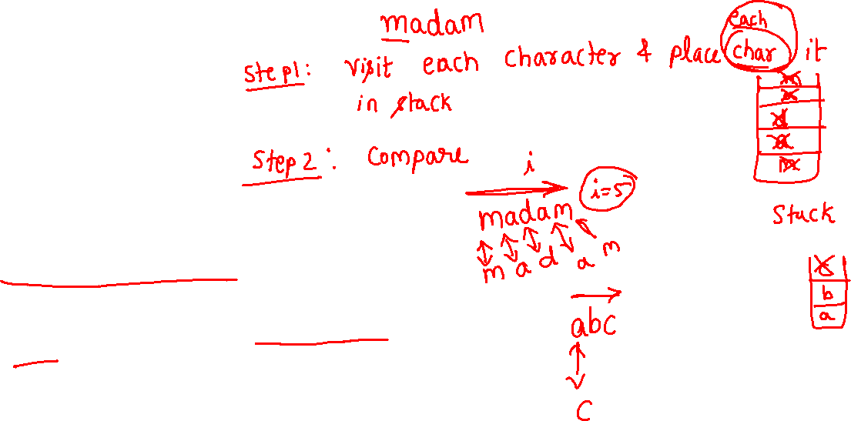
int main()
{
stack s(20);
int option,ele,i,len;
char ch,str[20];
cout<<"Enter a string: ";
gets(str);
i=0;
while(str[i]!='\0') i++;
len=i;
for(i=0;i<len;i++) s.push(str[i]);
i=0;
while(str[i]==s.pop() && i<len && s.Isempty()==FALSE) i++;
if(i==len-1 && s.Isempty()==TRUE)
cout<<str<<" string is palindrome";
else
cout<<str<<" string is not palindrome";
return(1);
}

Slide 23
#include<iostream>
#include<string.h>
using namespace std;
enum Boolean{FALSE,TRUE};
class stack
{ int top, a[20], maxsize;
public: //stack()
// { maxsize=2;top=-1;}
stack(int size)
{maxsize=size;top=-1;}
Boolean Isfull()
{
if(top==maxsize-1) return TRUE;
return FALSE;
}
Boolean Isempty()
{ if(top==-1) return TRUE;
return FALSE;
}
void push(char x);
char pop();
void display();
};
Base Conversion using Stack

Slide 24
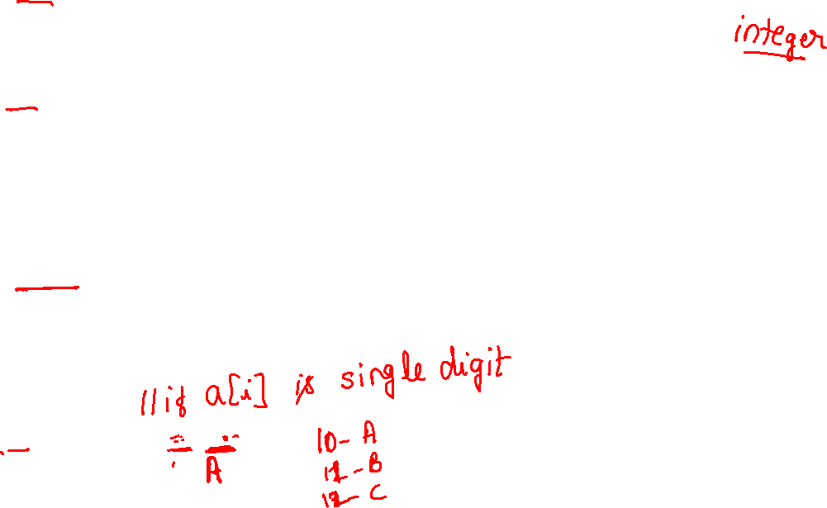
Base Conversion using Stack
void stack::push(int x)
{ if(Isfull()) cout<<"Stack is full \n";
else a[++top]=x;
}
int stack::pop()
{
if(Isempty())
{ cout<<"stack is empty\n"; return(-1); }
else return(a[top--]);
}
void stack::display()
{ if(Isempty()) cout<<"stack is empty\n";
else
for(int i=top;i>-1;i--)
{
if(a[i]<10) cout<<a[i];
if(a[i]>=10) cout<<(char)(a[i]+55);
}
}
a[i]’s value | a[i]+55 (int value) | Converted to char (ascii value of A is 65)
10 | 65 | A
11 | 66 | B
12 | 67 | C
13 | 68 | D
14 | 69 | E
15 | 70 | F

Slide 25
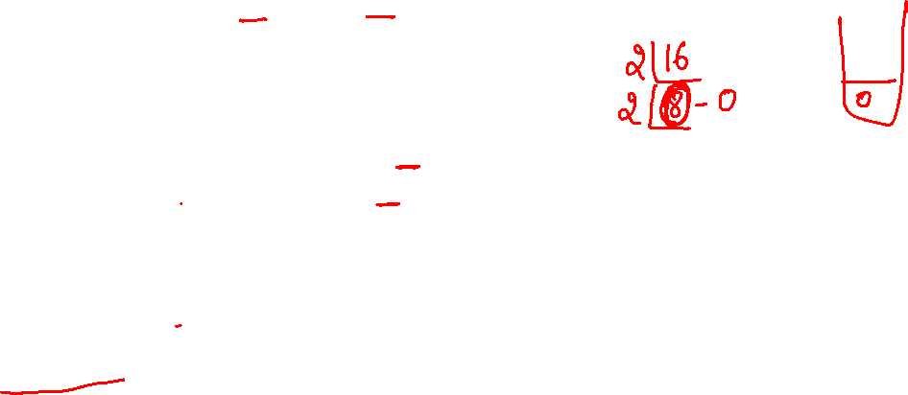
int main(void){
int MyNumber=239, base=16;
stack s(10);
while(MyNumber != 0){
int remainder = MyNumber%base;
int quotient = MyNumber/base;
s.push(remainder);
MyNumber = quotient;
}
s.display();
return 0;
}
Base Conversion using Stack

Slide 26
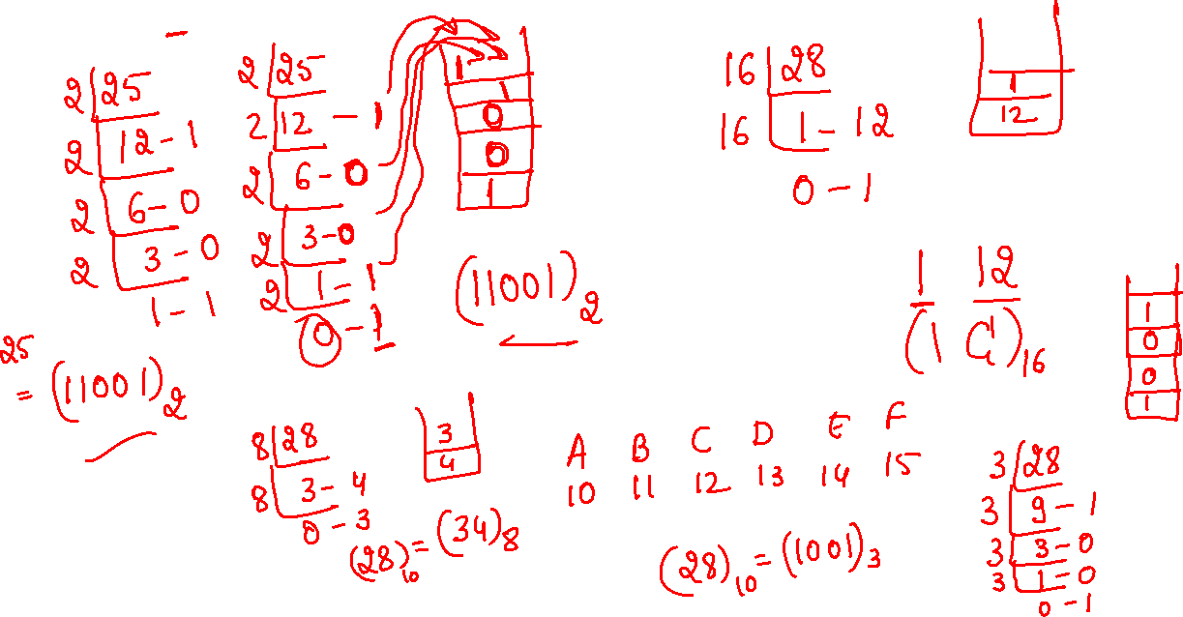
(25)₁₀=(11001)₂
(28)₁₀=(1C)₁₆

Slide 27
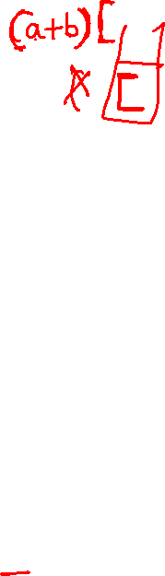
Balanced Parenthesis check using stack algorithm
Step 1: Read string S from user
Step 2: Assume that S has balanced parenthesis by making falg=1
Step 3: Find the length of the S and store it in variable ‘len’
Step 4: for each character in S // for i=0 to len-1 (i^{th} character is scanned character)
if scanned character is opening parenthesis (scanned char -> i^{th} character)
push scanned character into stack
else if scanned character is closing parenthesis
{
pop a character from stack
check if the popped char (opening parenthesis) is the matching pair of scanned character (closing
parenthesis)
if they are not matching make flag=0
break the for loop of step 4
}
else ignore scanned character
Step 5: For a balanced parenthesis expression stack would be empty and flag is 1.
whereas for an imbalanced parenthesis expression stack would NOT be empty or flag is 0.
Display appropriate message to user.

Slide 28
#include<iostream>
#include<string.h>
using namespace std;
enum Boolean{FALSE,TRUE};
class stack{ int top, maxsize; char a[20];
public:
stack(){ maxsize=2;top=-1;}
stack(int size){maxsize=size;top=-1;}
Boolean Isfull()
{
if(top==maxsize-1) return TRUE;
return FALSE;
}
Boolean Isempty()
{
if(top==-1) return TRUE;
return FALSE;
}
void push(char x);
char pop();
};

Slide 29
void stack::push(char x)
{
if(Isfull()) cout<<"Stack is full \n";
else a[++top]=x;
}
char stack::pop()
{
if(Isempty()) //Let pop return(‘x’) if stack is empty
{
cout<<"stack is empty\n"; return('x’);
}
else return(a[top--]);
}

Slide 30
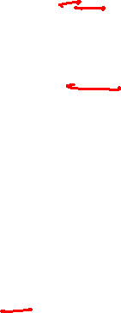
int main(){
int ii, len, flag=1; //Assume input has balanced parenthesis by making flag 1
char c[30], a;
stack s(10); //character Stack
cout<<"enter the expression: ";
cin>>c;
for(ii=0;c[ii]!='\0';ii++);
len=ii; //find length of string c and store it in len

Slide 31
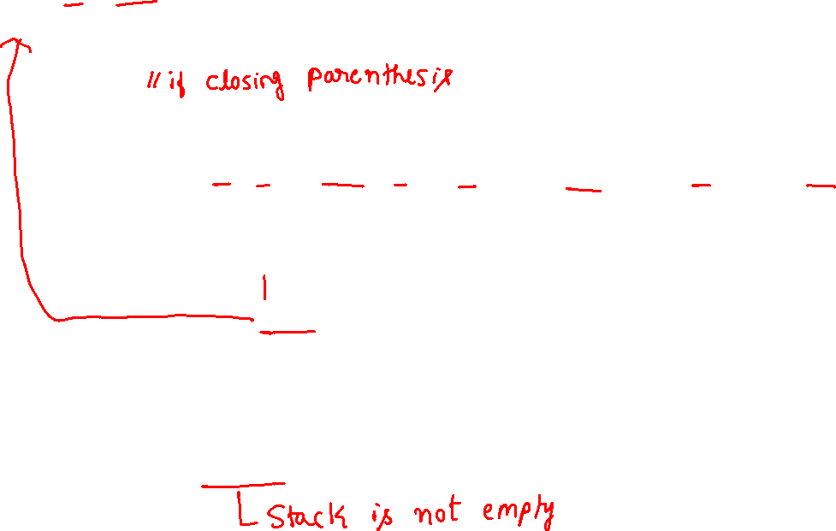
for (ii=0;ii<len; ii++)
{
if ((c[ii] == '(') || (c[ii] == '{') || (c[ii] == '[')) s.push(c[ii]);
else
{
a=s.pop();
if((a=='(' && c[ii]==')') || (a=='[' && c[ii]==']') || (a=='{' && c[ii]=='}') ) flag=1;
else
{ flag=0;
cout<<c<<" is imbalanced ";
break; // break the for loop
}
}
}
if (flag==1 && s.Isempty()) cout<<c<<" is a balanced expr!!";
else if(flag==0||!s.Isempty()) cout<<"invalid expr!!";
return(1);
}

